Slide 1

Testing software, and building Python packages
Data Sciences Institute
University of Toronto
Simeon Wong
Notes:
Hi everyone, welcome back to our 3rd week of Data Science Fundamentals

Slide 2
Previously at the DSI…
Documenting your code
Writing Python docstrings in the numpy style
Generating documentation websites with sphinx
Handling errors in Python
try / except
Raising your own exceptions
Raising exceptions vs. using assertions
Writing useful error messages
The python logging library

Slide 3
Course overview
Configuration files & Environment variables
Using and writing Application Programming Interfaces (APIs)
Handling errors
Testing software
Building Python packages
Working in software teams using GitHub features

Slide 4
Daily scrum
Write in the chat:
How you’ll use one thing you’ve learned so far
One thing you’re struggling with / wish the course addressed

Slide 5
Asking questions
Zoom chat during class
Feel free to post and answer questions at any time
I will pause for questions occasionally, and review questions from the chat
Pre- / Post-class office hours with Tong
Email
simeonm.wong@mail.utoronto.ca
tong.su@mail.utoronto.ca

Slide 6
Assessments
Outcomes-based learning
> 75% of course outcomes
Assessed with both in-class exercises and summative project
Summative project:
The next 4 classes build on each other
We will work on the summative project step-by-step through each class

Slide 7
Today’s learning outcomes
I can explain the importance of testing code
I can write unit tests and integration tests using pytest
I can run pytest from the command line and calculate code coverage
I can write a basic setup.py configuration file for setuptools
I can install a package from GitHub using pip

Slide 8
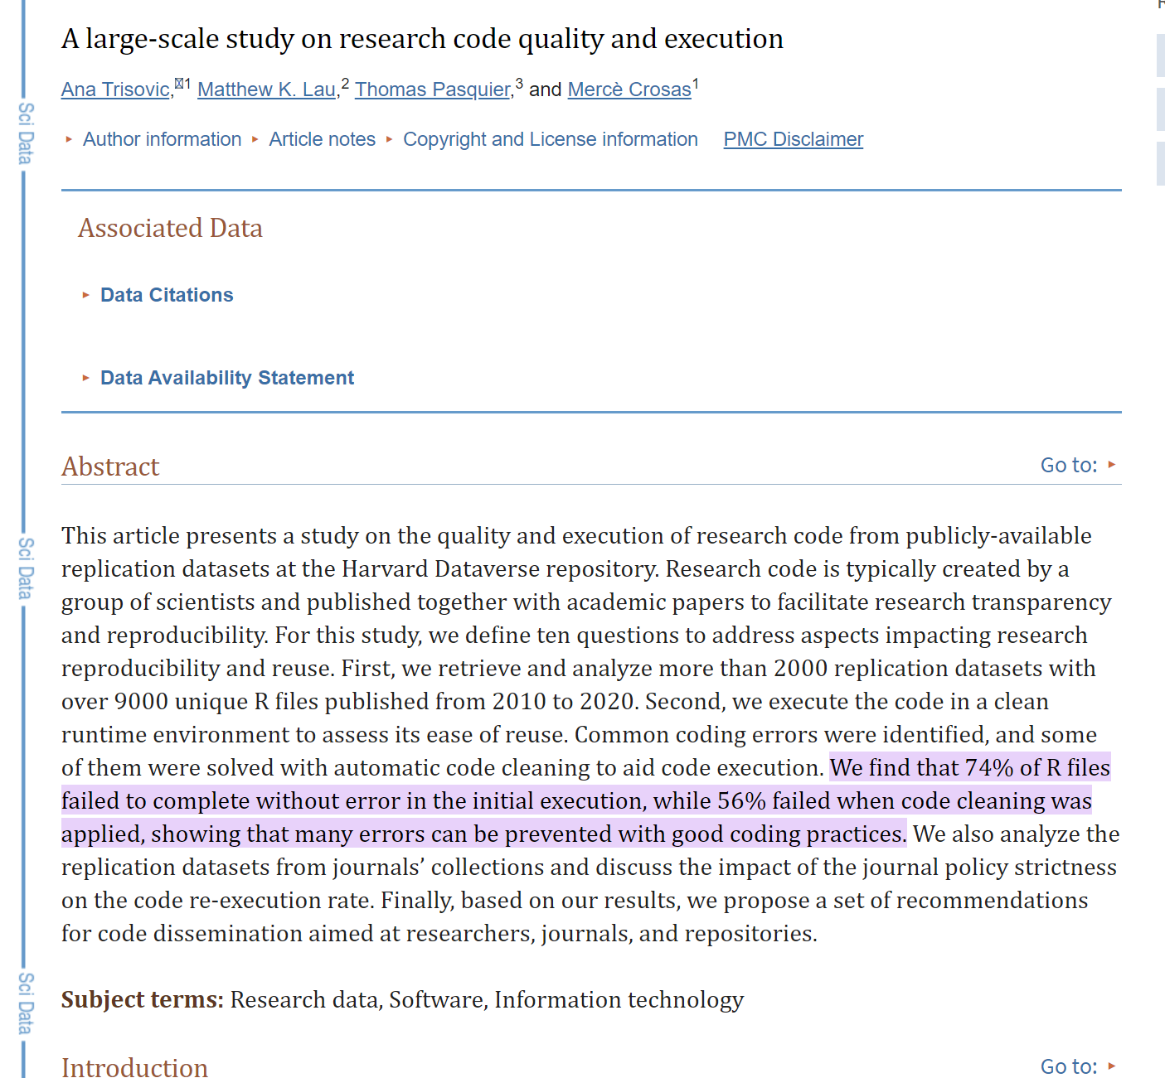


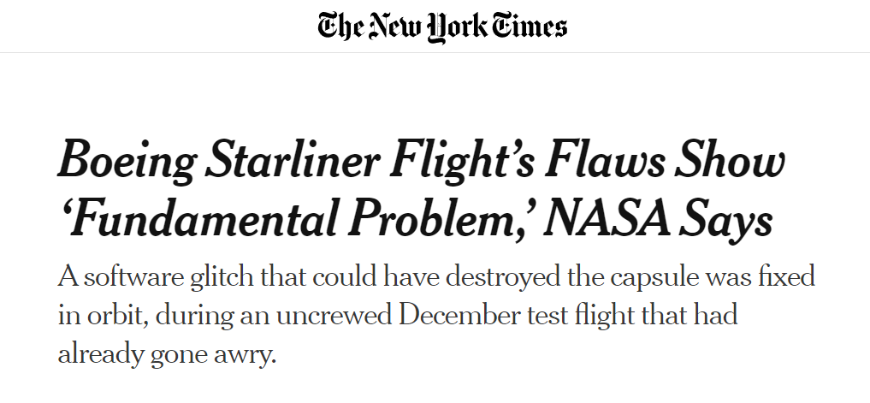
Why are tests an integral part of coding?
Testing software
Plainly Difficult

Slide 9
Why are tests an integral part of coding?
Testing software
We should always consider how the code needs to be tested when writing it
Impact and risk (code authority) vs. cost of testing
When using rm *.txt, it’s easy to double-check for typos and run ls *.txt first
It’s probably not worth writing an entire testing program with SOPs
Using ls *.txt is very low risk, so might decide to run first and check that way
Which parts of the code need more focus?
What are edge/unexpected cases that the code might need to handle?
Testing the code’s ability to gracefully and accurately handle errors

Slide 10
Testing as part of coding process
Testing software
Two common paradigms for testing
Test-driven development
Checking-driven development

Slide 11
Test-driven development
Testing software
Rather than writing code and then writing tests, we write tests first and then write just enough code to make them pass
Advocates claim that it leads to better code because:
Writing tests clarifies what the code is supposed to do.
It eliminates confirmation bias.
If someone has just written a function, they are predisposed to want it to be right, so they will bias their tests towards proving that it is correct instead of trying to uncover errors.
Writing tests first ensures that they get written.

Slide 12
Checking-driven development
Testing software
Writing just a few lines of code and testing it before moving on rather than writing several pages of code and then spending hours on testing
For example: every time we add a step to our pipeline
Look at its output
Write a test or check of some kind to the pipeline
Ensure that what we are checking remains true if it were run on other data or if the pipeline evolves

Slide 13
Some types of software testing
Testing software
← Individual lines of code
Systems scale →
Code review & static analysis
Integration test
Functional test
Unit tests
Performance/stress test
Tests get more expensive when hardware / systems / humans are in-the-loop
Other types of testing:
Security tests
Usability tests
Acceptance tests
All these tests are part of a comprehensive quality strategy

Slide 14
What questions do we have?

Slide 15
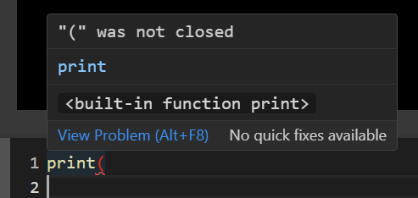
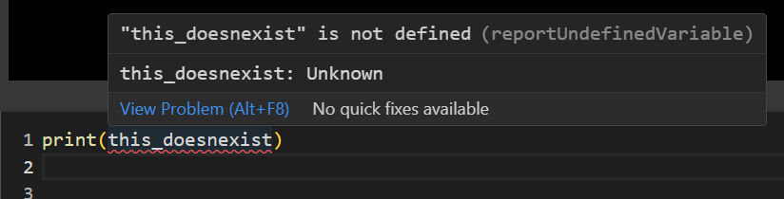
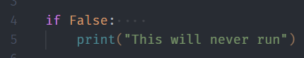

Static analysis
Testing software
Like spell check, but for code
Catches some common mistakes
Use before declare
Variable type issues
Syntax errors
Common analysis engines:
Python: pylance, pyflake
Bash: shellcheck

Slide 16
Unit tests
Testing software
A unit test checks of the correctness of a single unit of software.
What constitutes a “unit” is subjective, but typically it means the behavior of a single function in one situation.
A unit test will typically have:
a fixture, which is the thing being tested (e.g., an array of numbers);
an actual result, which is what the code produces when given the fixture; and
an expected result that the actual result is compared to
Easy to automate!

Slide 17
The pytest framework
Testing software
pytest is a testing framework that simplifies the creation, organization, and execution of tests.
Tests are put in files whose names begin with test_.
Each test is a function whose name also begins with test_.
These functions use assert to check results.
To add more tests, we simply write more test_ functions in this py file!

Slide 18
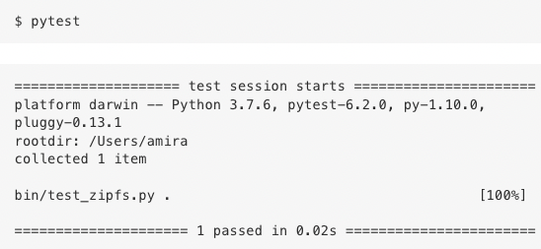
The pytest framework
Testing software
The pytest library can be used from the command-line.
When we run it with no options, it searches for all files in the working directory whose names match the pattern test_*.py

Slide 19
$> Interactive live coding
Testing software
Write function to calculate the area of a square:
calc_area_square(side_length:float) -> float
Write a unit test for this function

Slide 20
The pytest framework
pytest includes functions to write tests for special circumstances:
approx – for floating point calculations where some tolerance is expected
raises – for checking if an error is raised given erroneous input

Slide 21
$> Interactive live coding
Testing software
Write function to calculate the area of a circle:
calc_area_circle(radius:float) -> float
Write a unit test for this function
Add a test of whether the input is a valid number
Write a unit test for this error

Slide 22
Integration testing
Testing software
Integration testing is a test that checks whether the parts of a system work properly when put together.
Integration tests are structured the same way as unit tests:
a fixture is used to produce an actual result that is compared against the expected result.
However, creating the fixture and running the code can be considerably more complicated

Slide 23
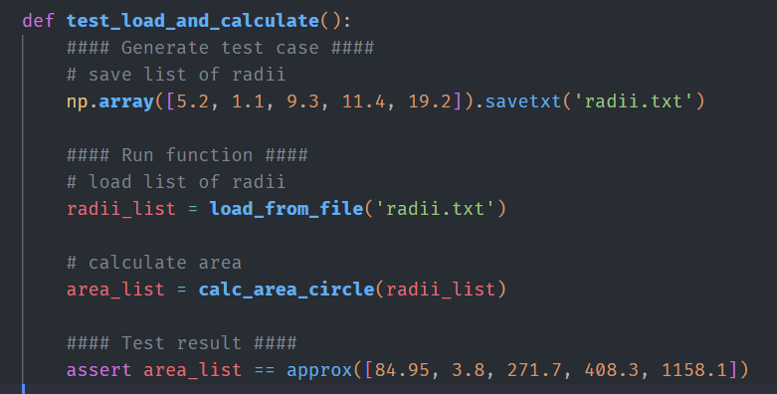
Example
Testing software
Testing a function that reads a list of radii from a text file and calculates the corresponding areas:

Slide 24
Regression tests
Testing software
When we don’t know the answer, we can use regression tests to compare today’s answer with a previous one.
This doesn’t guarantee that the answer is right
if the original answer is wrong, we could carry that mistake forward indefinitely
draw attention to any changes (or “regressions”)
Especially useful for large projects:
When dependencies are updated
When code is re-used in multiple places for different contexts

Slide 25
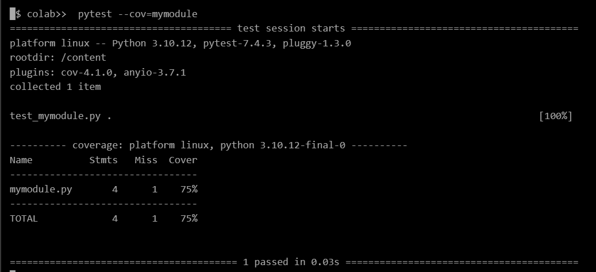
Test coverage
Testing software
How much of our code do we have unit and integration tests for?
We can instruct pytest to get the percentage of lines of code that have been tested.

Slide 26
What questions do we have?

Slide 27
Continuous integration
Testing programs
Automatically run all tests whenever a change is made
Visibility into which changes resulted in errors
Integration tests help catch errors affecting other parts of the code, or errors resulting from operating system or system interactions
GitHub Actions is a built-in way to do CI
Usually configured to run on every single push
Can run pretty much any command (e.g. pytest) on the code

Slide 28
GitHub Actions
Testing programs
Defined in a YAML file placed in .github/workflows
name: Run unit tests
on: [push]
jobs:
my_pytest:
runs-on: ubuntu-latest
steps:
- …
Name of your workflow
When should this run?
What should happen when it runs?
Base system to run this action on
What steps?

Slide 29
$> Interactive live coding
Testing software
Create a GitHub repository for our circle code with unit tests
Try pytest locally
Write a GitHub Actions file to run pytest on push

Slide 30
What questions do we have?

Slide 31
Course overview
Configuration files & Environment variables
Using and writing Application Programming Interfaces (APIs)
Handling errors
Testing software
Building Python packages
Working in software teams using GitHub features

Slide 32
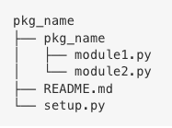
Creating a Python package
Python packages
A generic package folder hierarchy has:
a top-level directory with the package name
↳ that contains a directory that is also named after the package
↳ that contains the package’s source files
Modules can contain functions and classes

Slide 33
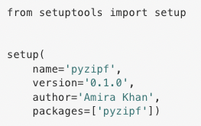
setuptools
Python packages
Using setuptools allows everyone, regardless of Python distribution, to use our package
setuptools attempts to install package requirements automatically
The setup.py file defines some properties of our package

Slide 34
Testing packages
Python packages
Install the package
in a fresh Python installation (to make sure it’s compatible with everyone)
in editable mode (for easy debugging)
pip install –e /path/to/package
After installation, the code can be imported
from my_package import my_module

Slide 35
Distributing packages
Python packages
Python has a default repository: the Python Package Index (PyPI)
Packages are publicly and freely available to everyone
When you run pip install, it usually downloads from there
Beware of installing packages indiscriminately.
Anybody can contribute a package to PyPI
Although eventually delisted, there have been malicious packages
Companies and research groups will often have private repositories, or keep packages in a private GitHub Organization for internal use

Slide 36
Semantic Versioning
Python packages
Semantic versioning is a widely adopted notation for indicating versions or changes to software
Standard format: major.minor.patch (e.g. version 1.2.1)
Major: Incompatible API changes (breaking changes)
Minor: New functionality, where the existing usage is not affected
Patch: Bug-fixes and other changes with little impact to the user
Predictable upgrades and backwards compatibility
“Will everything break if I upgrade?”

Slide 37
$> Interactive live coding
Python packages
Create a simple Python package
Install using pip
Upload to GitHub
Install using pip in another instance

Slide 38
Today’s learning outcomes
I can explain the importance of testing code
I can write unit tests and integration tests using pytest
I can run pytest from the command line and calculate code coverage
I can write a basic setup.py configuration file for setuptools
I can install a package from GitHub using pip

Slide 39
Course final assignment
Logistics
Available on GitHub: https://github.com/dtxe/UTDSI_202401_building_software/blob/main/assignments/Assignment.md
The last hour of Tuesday’s class will be working on this assignment
The final assignment is an extension of the assignments so far
Due Tuesday, Jan 16th at 23:59 (before midnight)

Slide 40
Exercise + Assignment
Create a Python package
Write one or more unit test for your API code
Commit and push your changes to the same repository
Optional: Use GitHub Actions to automatically run your unit tests
Submit your work here: https://uoft.me/dsi-1-bs-a2

Slide 41
References
Research Software Engineering with Python by Damien Irving, Kate Hertweck, Luke Johnston, Joel Ostblom, Charlotte Wickham, and Greg Wilson (https://merely-useful.tech/py-rse/config.html)

